Slide 1
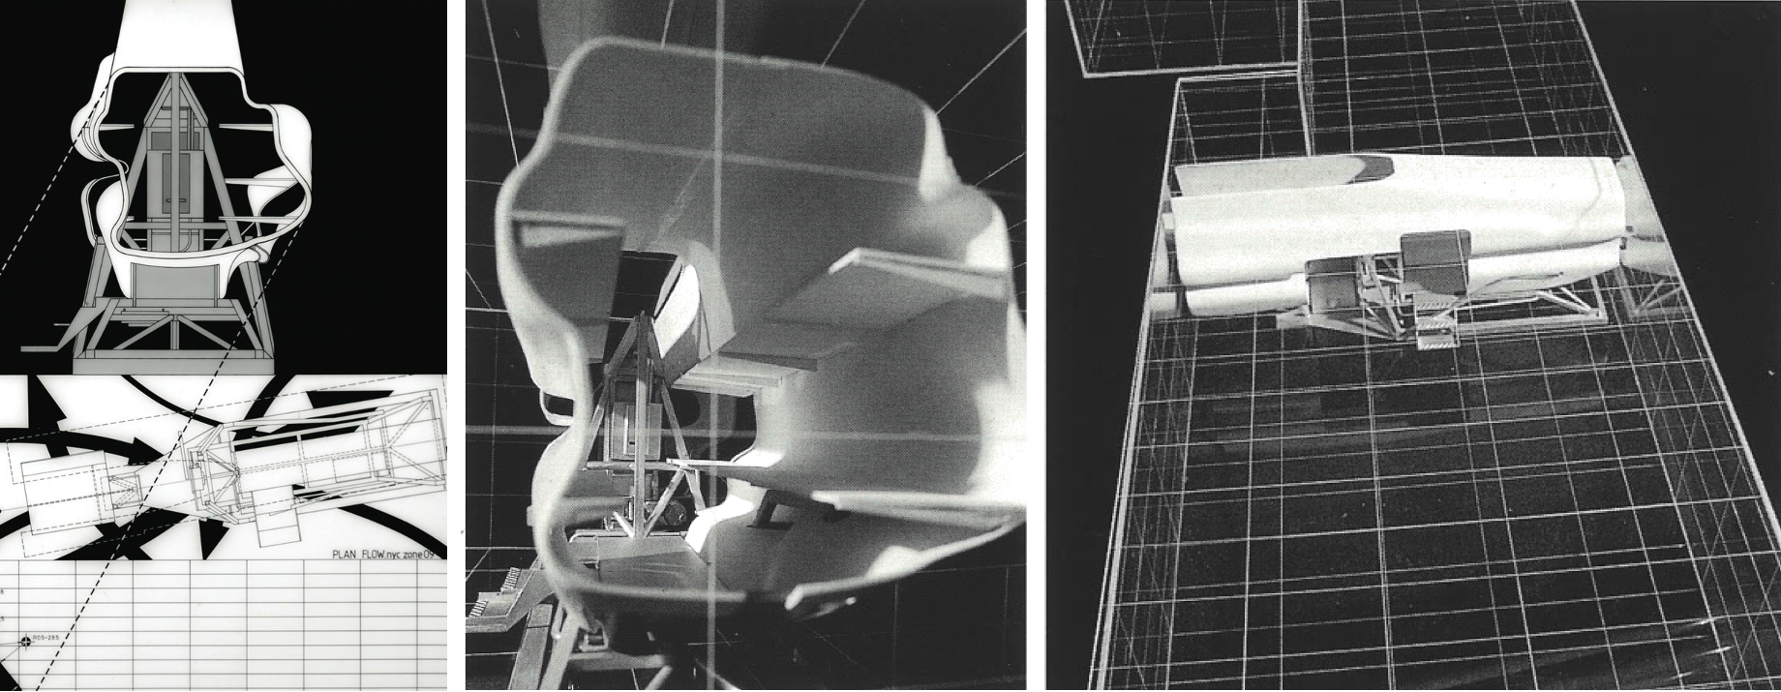
Introduction to Architectural Design I / CAD I
RB @VGU
BSc 1: Architectural Embodiments
WHAT

Slide 2
Introduction to Architectural Design I / CAD I
RB @VGU
Dr.-Ing. Henriette Bier, Associate Professor TUD, Visiting Professor AUAS
WHO

Slide 3
Denari (1993)
Notes:
The design assignment will focus on American’s architect Neil Denari’s project, which is a space separator.

Slide 4
Architecture is both the process and the product of planning, designing, and constructing buildings.
Buildings are characterized by features that make them historically identifiable categorized as styles. Styles include aspects such as form, function, method of construction, materials, and local/regional character.
Architecture is classified within a chronology of styles which changes over time reflecting respective ideologies, fashions, beliefs, technologies, and materials.

Slide 5
Assignment:
Architectural embodiments as tangible and visible forms of ideas are defined in the context of the design studio as variations derived from one architecture.
Based on analysis and reflection on Neil Denari’s space separator students will develop variations of it as their own designs. Alternative function, form, method of construction and materials are speculated upon.
Considering that the supporting frame is made of welded aluminium and the skin is made of moulded fiberglass the students are encouraged to speculate about possible alternative materials (wood, bamboo, stone, glass, etc.) and their impact on design. Furthermore, they are encouraged to speculate on alternative functionalities and forms.
Architectural Design I:
Culture and Society: Analysis of structural situations with regard to history, culture and society and their interaction with human needs
Measure of Man: Studies on the development of space and form in relation to human behavior patterns and motion sequences.


Slide 6
Design Studio: Applying analysis of design assignment with the aim of developing body, space, form and function as an architectural embodiment; Creating analogue models and digital three- and two-dimensional representations in the form of 3D models, floor plans, sections and views implemented at various scales; Determining the basics of the design task, deriving a space concept with a fixed construction volume for a specific location; Designing the form, function, construction and appearance of the architectural embodiment.
Tasks:
Describe project using text and images;
Describe design in text, image, scaled analogue/digital models.
Requirements:
±500 words report;
Design variant embodiment (3D model, renderings, 2D sections and plans, views).

Slide 7
Computer-aided Design (CAD) I:
Data organization, systematics of electronic data processing (EDP) and CAD.
Text processing, standard-compliant reports / business letters, formatting spreadsheets, working with simple formulas and calculations.
CAD (2-3D): Project structure, drawings, images and layers.
Create and modify lines and geometric shapes.
Architectural 2D drawings such as floor plans, sections and views at scale (using hatching, labelling and dimensioning).
Furnishing, plan processing and plan output.
Tasks:
Describe employed EDP and CAD methodology using text and images;
Describe design in text, image, scaled analogue/digital models.
Requirements:
500 words report describing CAD methodology and approach using text and images;
3D models and architectural 2D drawings at various scales.

Slide 8
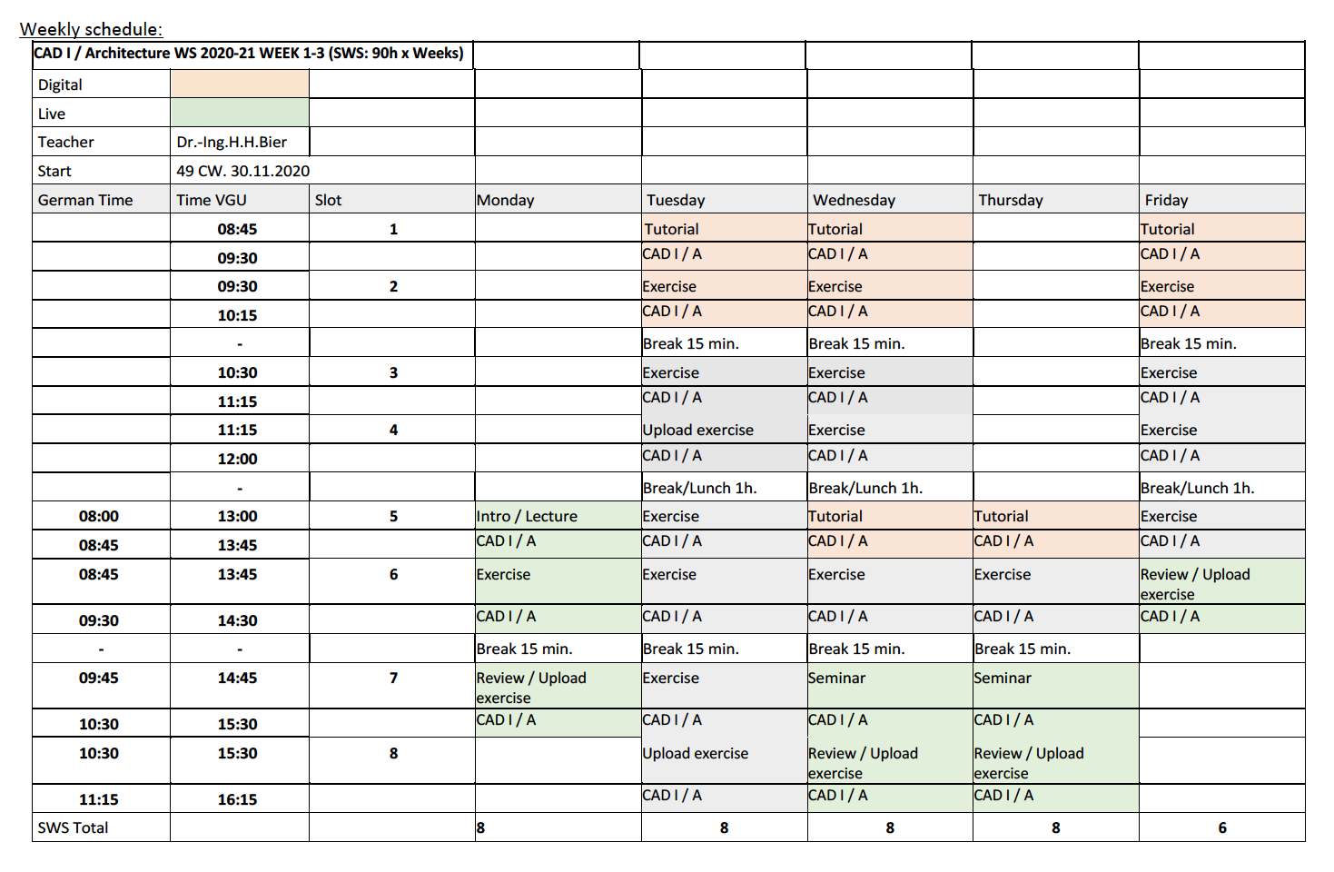

Slide 9
1 WEEK
Monday
Lecture
Introduction to CAD I and Architectural Design I / Culture and Society: Analysis of structural situations with regard to history, culture and society and their interaction with human needs / Multi-media (re-)presentation
Tutorial
Developing multi-media presentation using PPT.
Following 2-3D modelling tutorials in Rhino and developing own models.
Exercise
Understand structure of tutorials and test the individual use of tutorials.
Analyse in groups of 6 students Denari's drawings in order to understand the project functionally and spatially (what are the spaces used for, how big they are and what activities do or could they accommodate, etc.) / Identify alternative use and functional distribution (while preserving the separation between front and back), etc.
Prepare 3 PPT-presentations (one per each group) showing results of the analysis.
Seminar/Review (±2.0h)
Present orally PPTs and discuss results of analysis in PechaKucha style (https://en.wikipedia.org/wiki/PechaKucha).
Q&A and discussion on Tutorials and Exercises for next day.

Slide 10
1 WEEK
Tuesday
Tutorials
Data organization, systematics of electronic data processing (EDP) and CAD (data storage, file formats, translating and sharing).
CAD (2-3D): Project structure, drawings/models, images and layers (import image in Rhino, trace lines, extrude, etc.) / Create and modify lines and geometric shapes.
CAD (2-3D): Develop simplified model of the replica.
Exercise
CAD (2-3D): Develop own project structure, drawings/models, images and layers (import image of sections in Rhino, trace lines, tilt/rotate, extrude, etc.) / Create and modify lines, surfaces and 3D geometric shapes.
CAD (2-3D): Develop individual simplified model of the replica.
Corbusier: Towards a New Architecture (read text and prepare PechaKucha style PPT-presentations organised in 3 groups of 6 students each; groups 1-3 read pp. 21-65, pp. 85-129, and pp. 149-199, respectively whereas each student reads ±7 pages, summarizes the content, and discusses it with his group mates).

Slide 11
1 WEEK
Wednesday
Tutorials
CAD (2-3D): Develop simplified 3D model of the replica (create and modify lines surfaces and 3D geometric shapes); Develop simplified model of the replica (create surface tectonics i.e. facettation, create simple horizontal and vertical sections).
Exercise
CAD (2-3D): Develop individual simplified model of the replica (create and modify lines surfaces and 3D geometric shapes).
Prepare individual PPT-presentations in PechKucha style showing individual simplified model of the replica.
Seminar/ Review
Corbusier: Towards a New Architecture (present PPT-presentation in PechKucha style and discuss content).
Present individual simplified model of the replica as 3D model. Q&A and discussion on Tutorials and Exercises for next day.

Slide 12
1 WEEK
Thursday
Tutorials
CAD (2-3D): Develop individual simplified model of the replica (create surface tectonics i.e. facettation, create simple horizontal and vertical sections) and prepare PPT-slides in PechaKucha style.
Relevant literature BSc I (read text organised in 3 groups pages pp. 18 and 25, pp. 19-21, and pp. 22-24 and prepare 3 PPT-presentations in PechaKucha style).
Seminar/ Review
Relevant literature BSc I (present PPT-presentations in PechaKucha style and discuss content).
Present individual simplified model of the replica PPT-presentations in PechaKucha style. Q&A and discussion on Tutorials and Exercises for next day.

Slide 13
1 WEEK
Friday
Tutorials
CAD (2-3D): Finalise simplified model of the replica.
Exercise
Finalise simplified model of the replica and compile PPT-slides in PechaKucha style to present final 3D model of the replica.
Review
PPT-presentations in PechaKucha style and discussion of final 3D model of the replica.

Slide 14
Notes:
Original and simplified replica

Slide 15
Notes:
Where the replica is generated and modified according to certain rules inspired by architects such as Lebbeus Woods, Peter Eisenman, Eric Own Moss, etc.

Slide 16
Notes:
The inspiration has not only a formal component but also a material one: I this case the material flatten metal sheets.

Slide 17
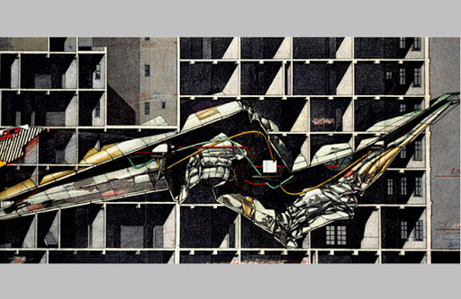
Notes:
Woods

Slide 18
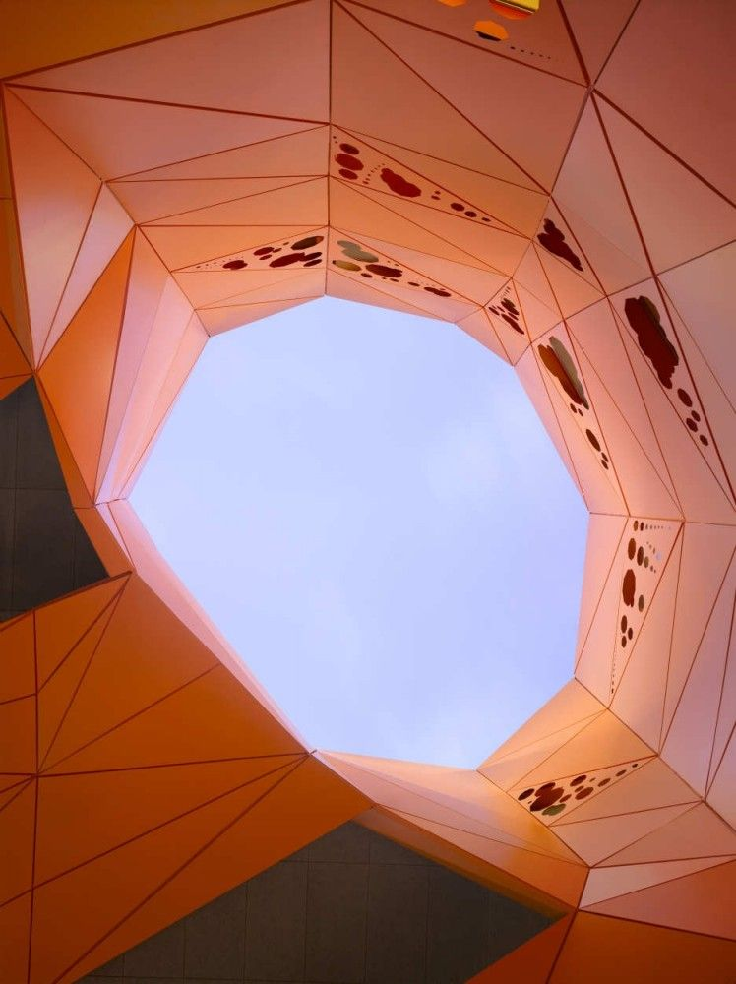
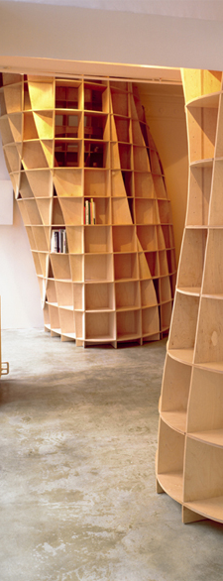
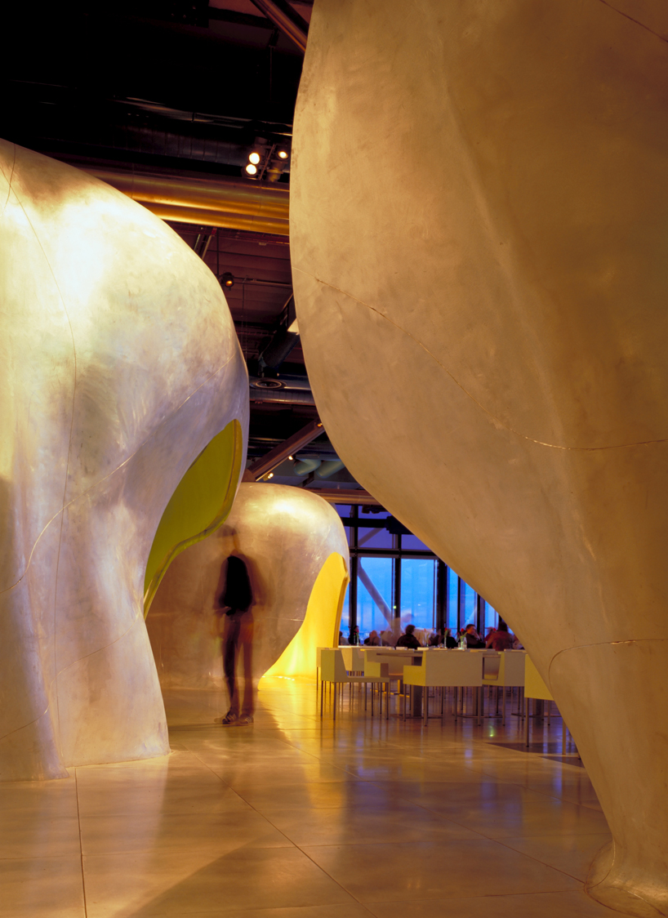
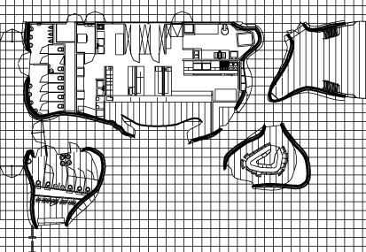
Facetted vs. Curvilinear
Notes:
or JAKOB+MACFARLANE (wood and metal)

