Slide 1
SEPARATOR DESIGN PROJECT Lecturer: Dr. Henriette Bier CAD Instructor: Max Latour
Nguyen Vu Minh Thu
ID: 16759
Vietnamese German University

Slide 2
Indoor pavilion - inspiration from folded origami maquettes.

Slide 3
Current problem from the Denari’s
leveling frame → no visual privacy
rough path of the staircase
Initial envelop sketch
Function sketch

Slide 4
Requirements:
Stress and depression reduction in the workplace
→ A space to relax, interact with their colleges, boost their productivity and creativity at work.
Initial floor plan sketch

Slide 5
Functions:
For employees:
common hallway with sitting, lying area and bookshelves
a green wall to grow vegetables and herbals
For customer:
showcase shelves
Material:
timber
→ ease of construction, sustainability, sound absorption and aesthetics
Interior front section
Interior left section
Interior back section

Slide 6
The top view: modernism styled with simple volume
The envelop: deconstructivism styles with lines, random compositions of shapes and angles.
→ Consistent architectural language was on both envelop and supporting structure
Perspective view

Slide 7
The green wall

Slide 8
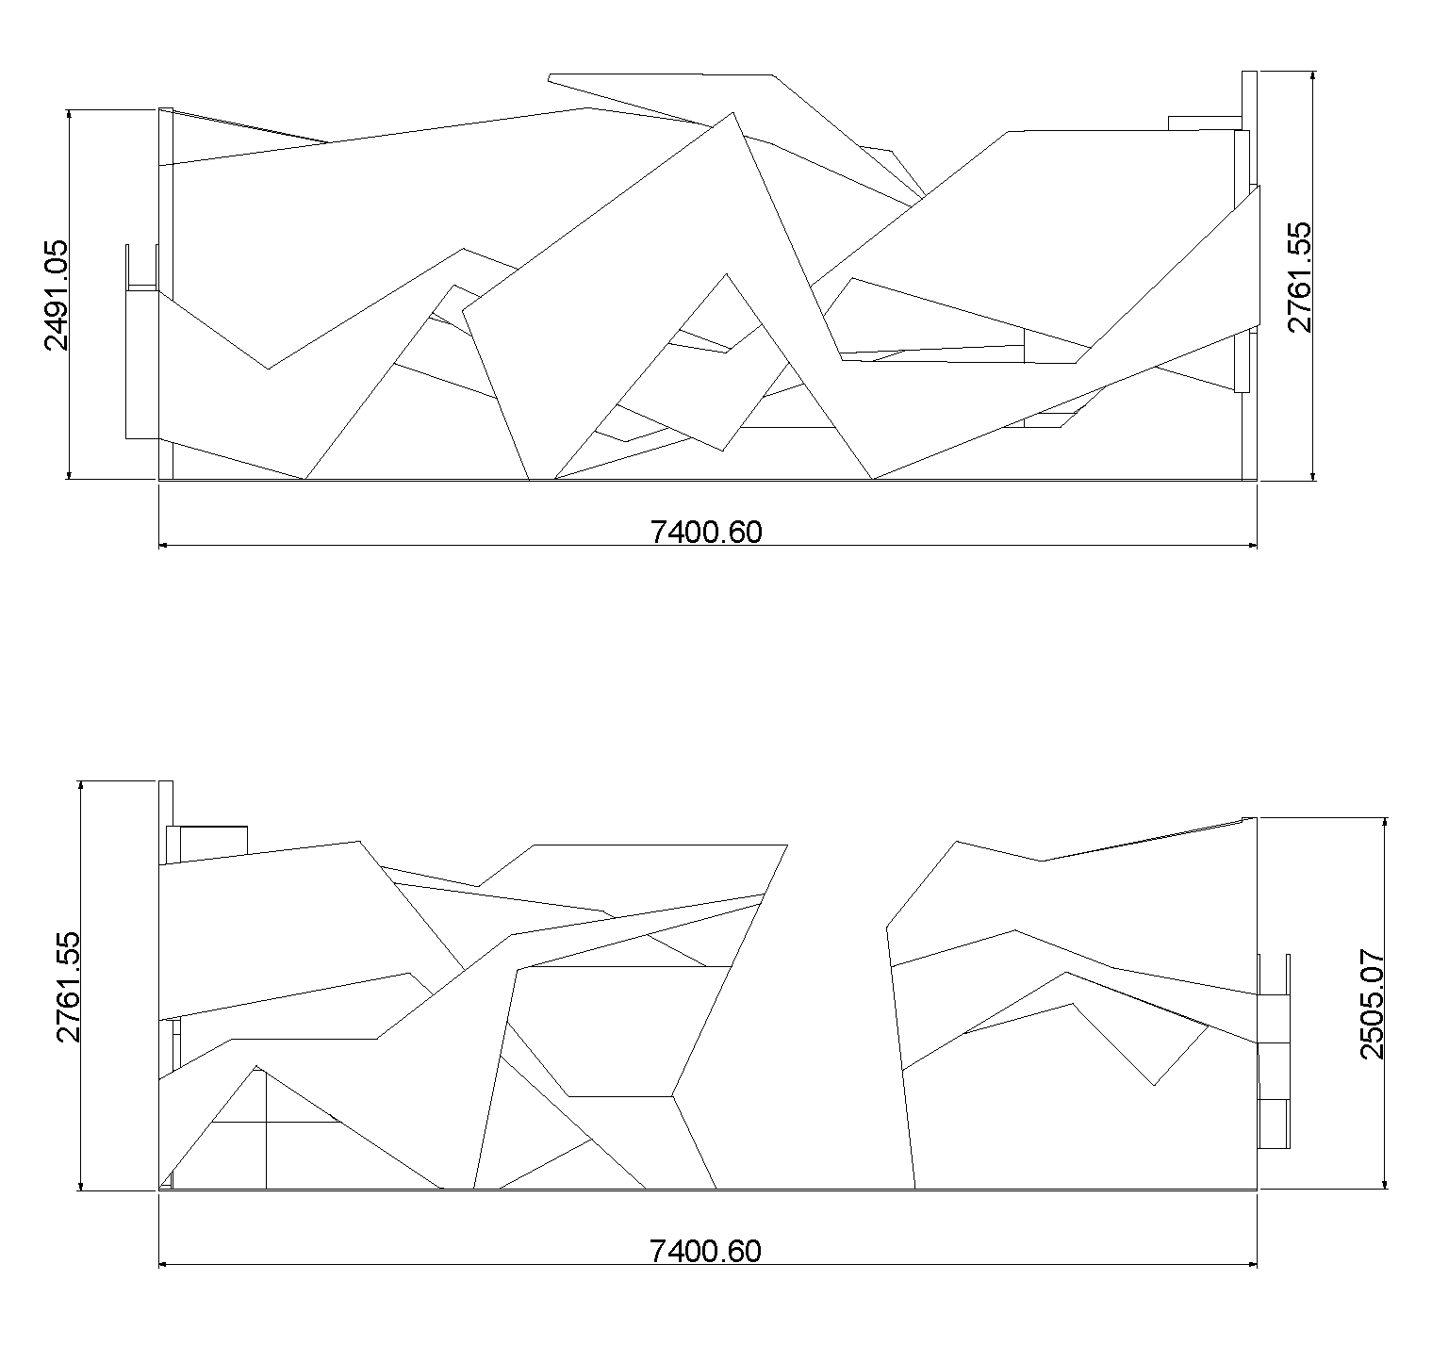
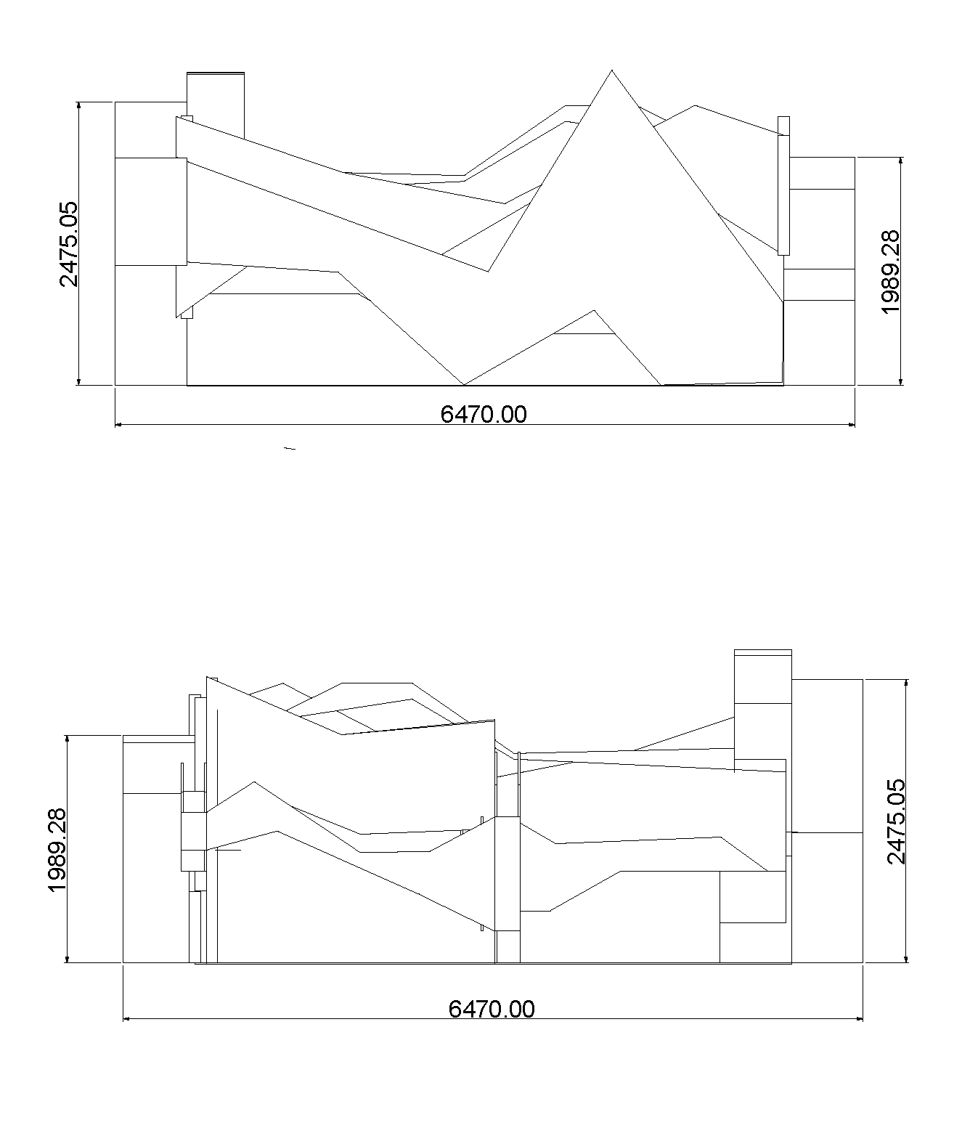
PLANS
Back view
Left view
Front view
Right view

