Slide 1
1:1 Interactive Architecture Prototypes
Week 3
Group 3
Daphne, Julia, Pragya & Roy

Slide 2
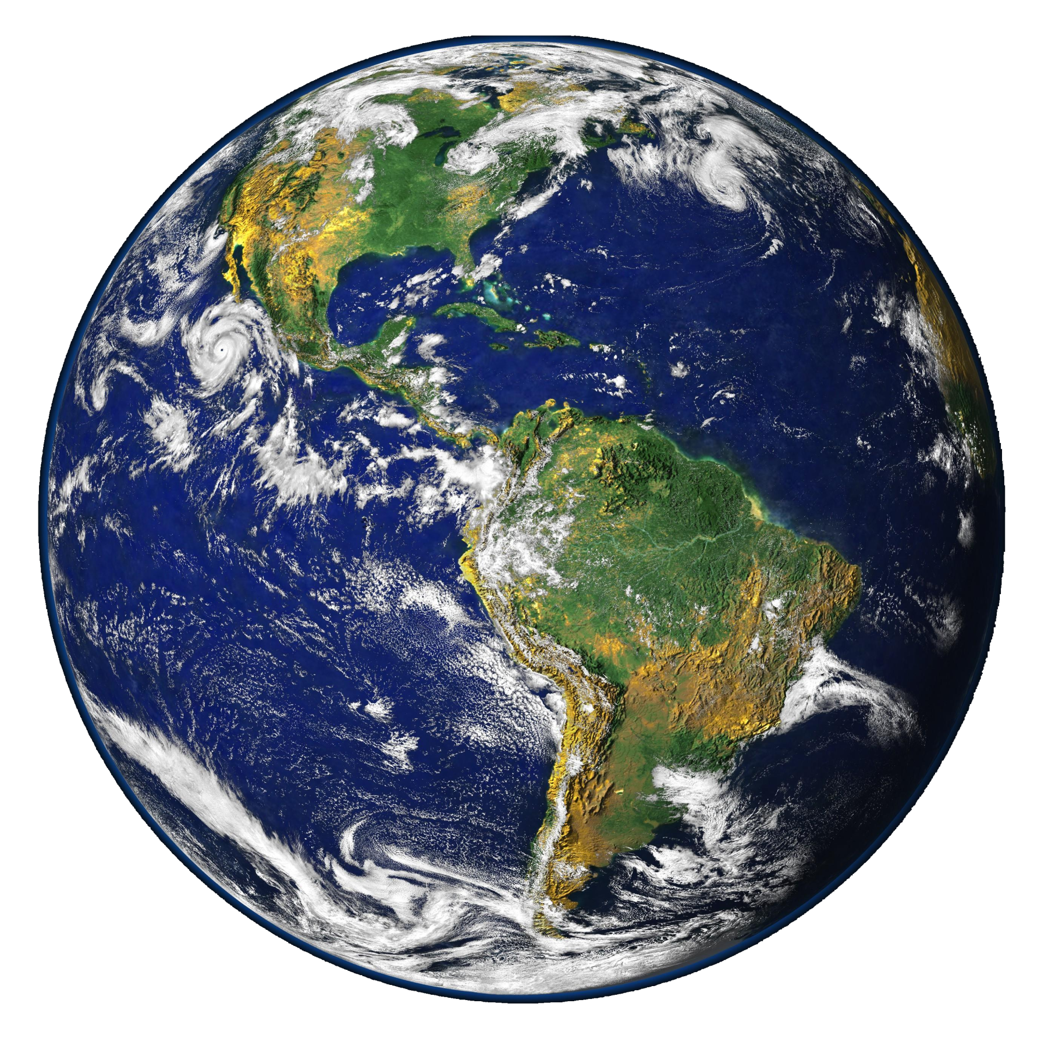
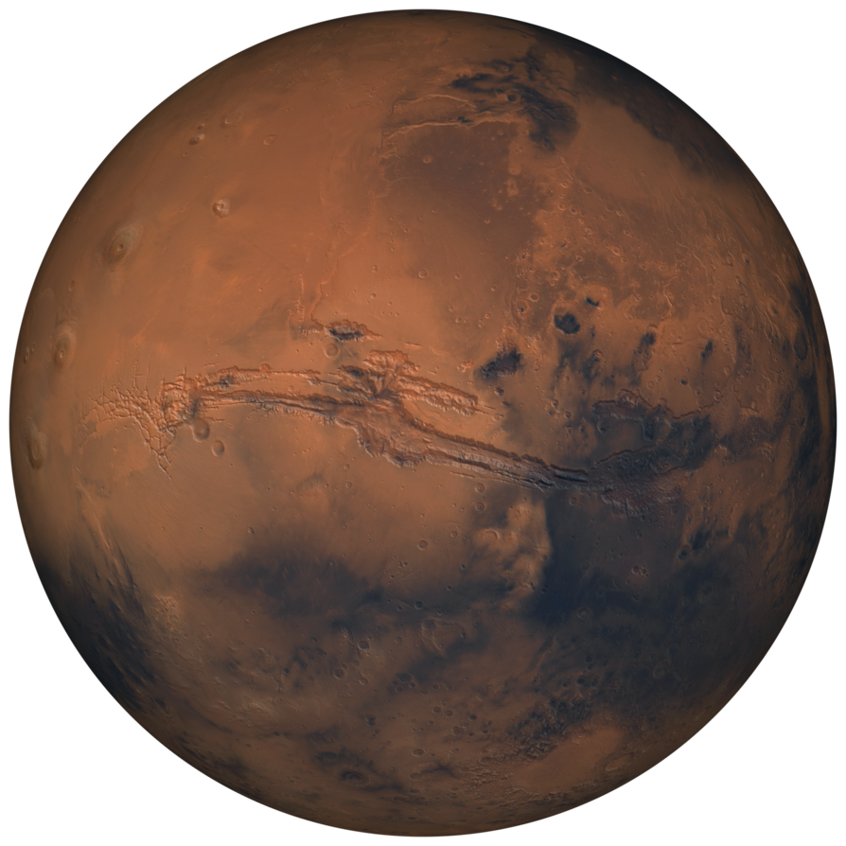
Content
1. Analysis
1.1 - Context
1.2 - Materials
1.3 - Voronoi structures
2. Design proposal
2.1 - First Concept
2.2 - Form
2.3 - Function
9 : 1

Slide 3
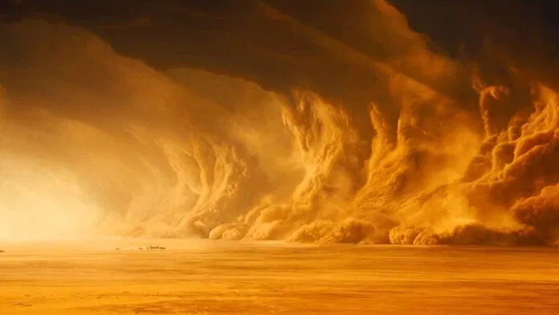
1.1 - Context
Climate & Weather
Snow fall
Wind storms
Cover all planet with dust
Wispy clouds
1/1000th of the Earth's water

Slide 4
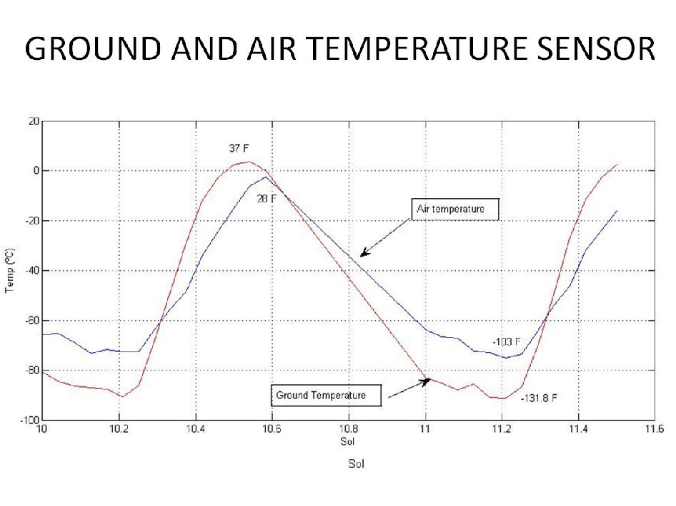
1.1 - Context
Climate & Weather
Annual surface temperature
Min. 120 K
Max. 293 K
Daily surface temperature
90 K difference

Slide 5
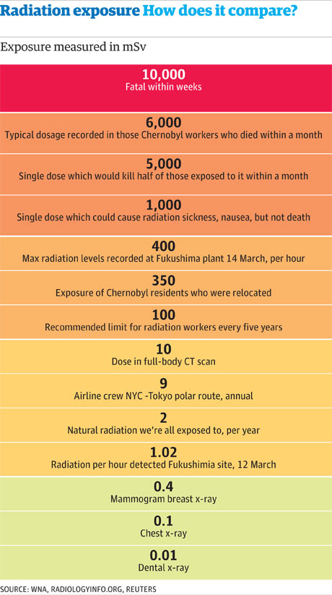
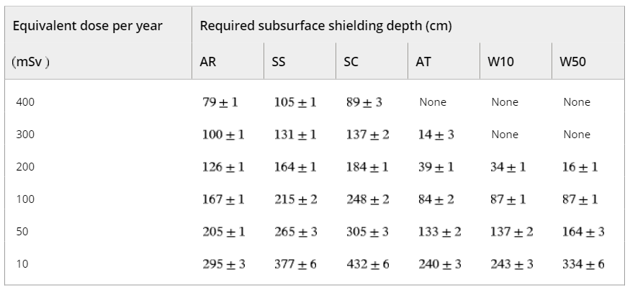
1.1 - Context
Radiation
Annual equivalent 100 mSv on Mars
87 cm - 167 cm
Max annual equivalent dose adults
1 - 10 mSv
> 295 cm - 334 cm
Note. AR = andesite rock; SS = sandstone; SC = sulfur concrete; AT = Arabia Terra; W10 = 10% water in the andesite rock; W50 = 50% water mixture with andesite rock.

Slide 6
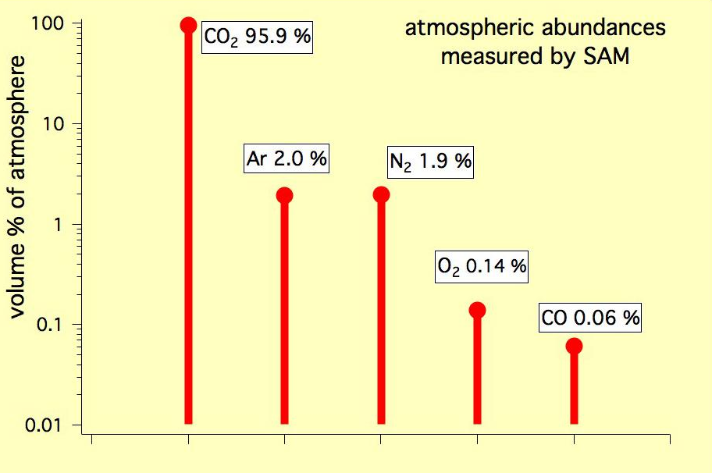
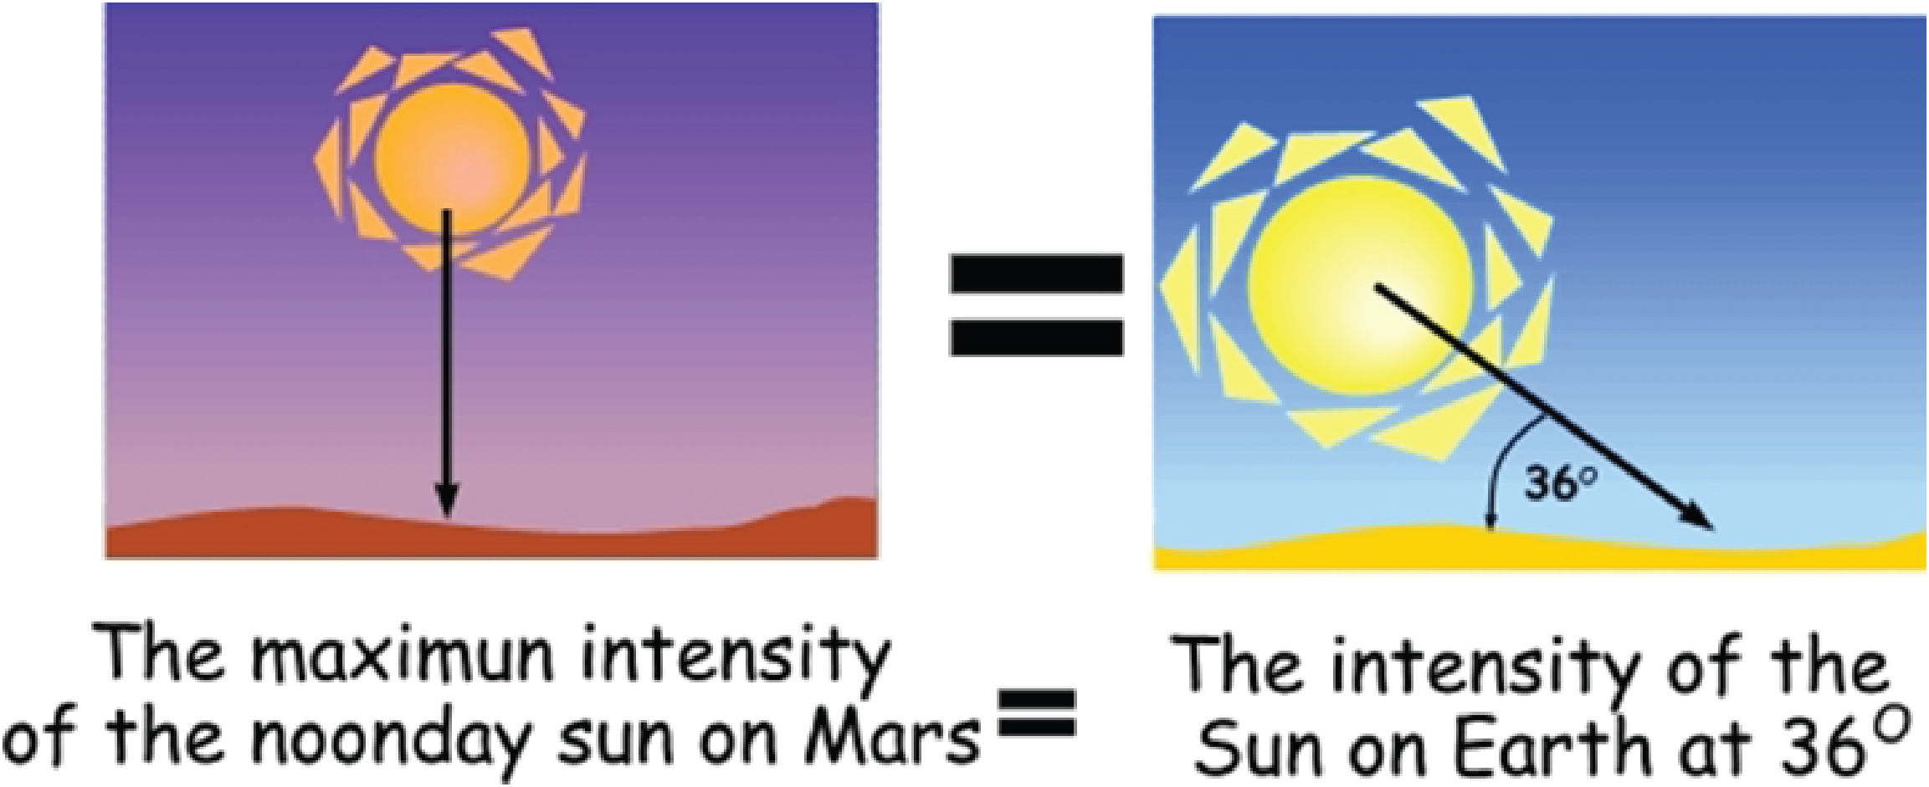
1.1 - Context
Atmosphere
Atmospheric composition by mass
76.2% oxygen
11.1% carbon
10.1% hydrogen
2.6% nitrogen
Sunlight
Irradiance 590 W/m2 (Earth 1000 W/m2)
Comparable to March in the Netherlands
NASA/JPL-Caltech, SAM/GSFC

Slide 7
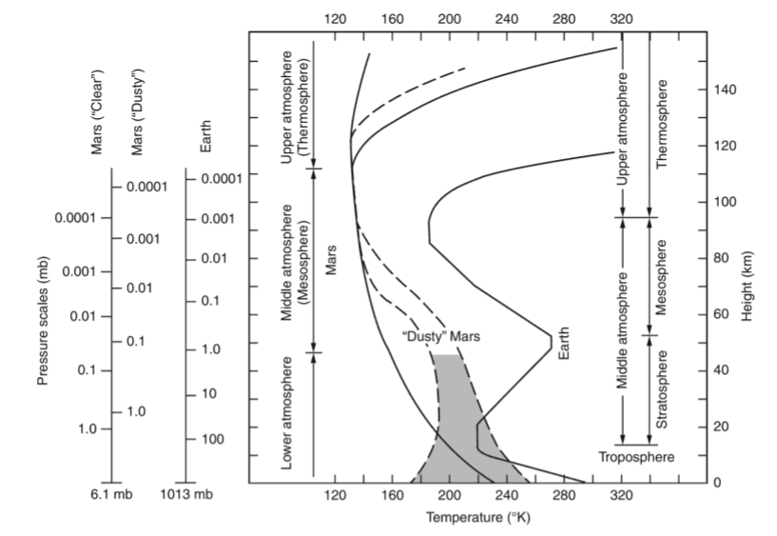
1.1 - Context
Atmosphere
Standard pressure and temperature Mars compared to Earth
Inversely proportional
Clear or dusty
Haberle, R. M., Clancy, R. T., Forget, F., Smith, M. D., & Zurek, R. W. (Eds.). (2017). The atmosphere and climate of Mars. Cambridge University Press.

Slide 8
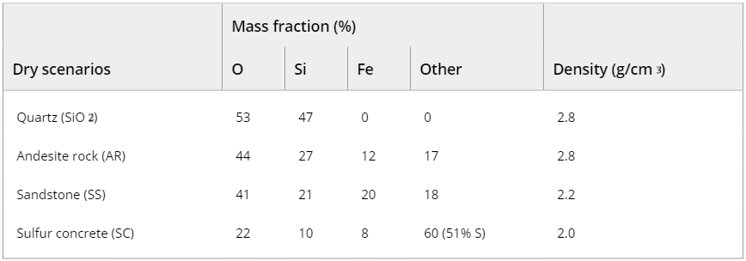
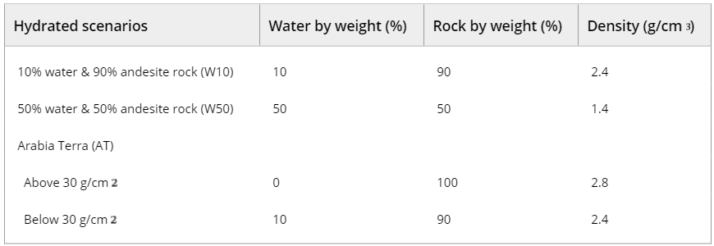
1.1 - Context
Soil & Raw Materials
No organic matter on Mars, no soil
Regolith

Slide 9
1.2 - Materialization
Factors Considered
Visibility (Opaque, translucent or transparent?)
Thickness and Strength
Where is the material from?
Possibility to print better surface details and sharper features (Scale of printing)
Performance in Mars temperatures (how long will the material last?)
Recyclability

Slide 10
1.2 - Materialization
Factors Considered
 | PLA (Polylactic Acid) | Martian Concrete
Composition | Thermoplastic | Sandstone, Sulphur Concrete, Andesite Rock, Arabia Terra
Visibility | Translucent, Transparent (on applying coats and finishes) | Opaque
Location / Procurement | Earth | Mars
Detailing | Smaller components (lesser quantity) | Bulk mass of Structures
Performance | (to be assessed) | (to be assessed)
Recyclability / Repair | Yes | Yes

Slide 11
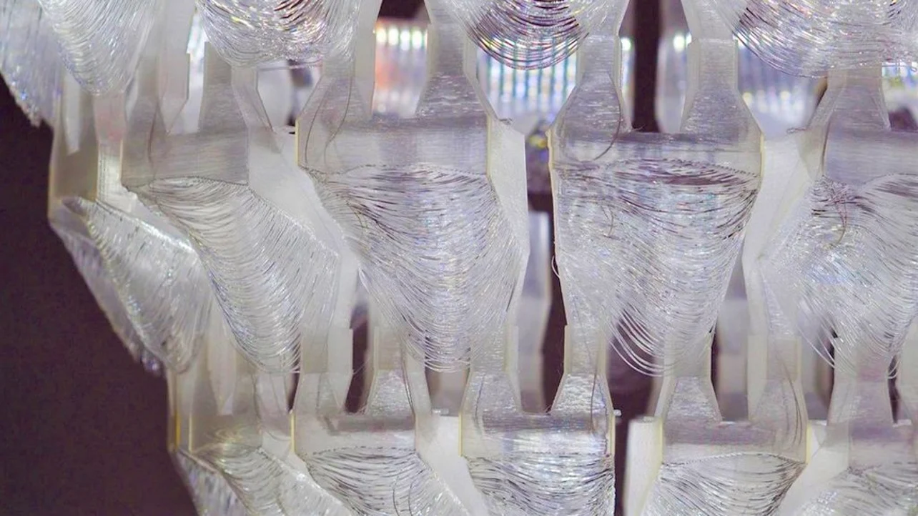
1.2 - Materialization
PLA
transparent
is easily pigmented or painted
can be mixed with wood, carbon and metal
can be sanded and polished to get finer textures
accuracy
tensile strength

Slide 12
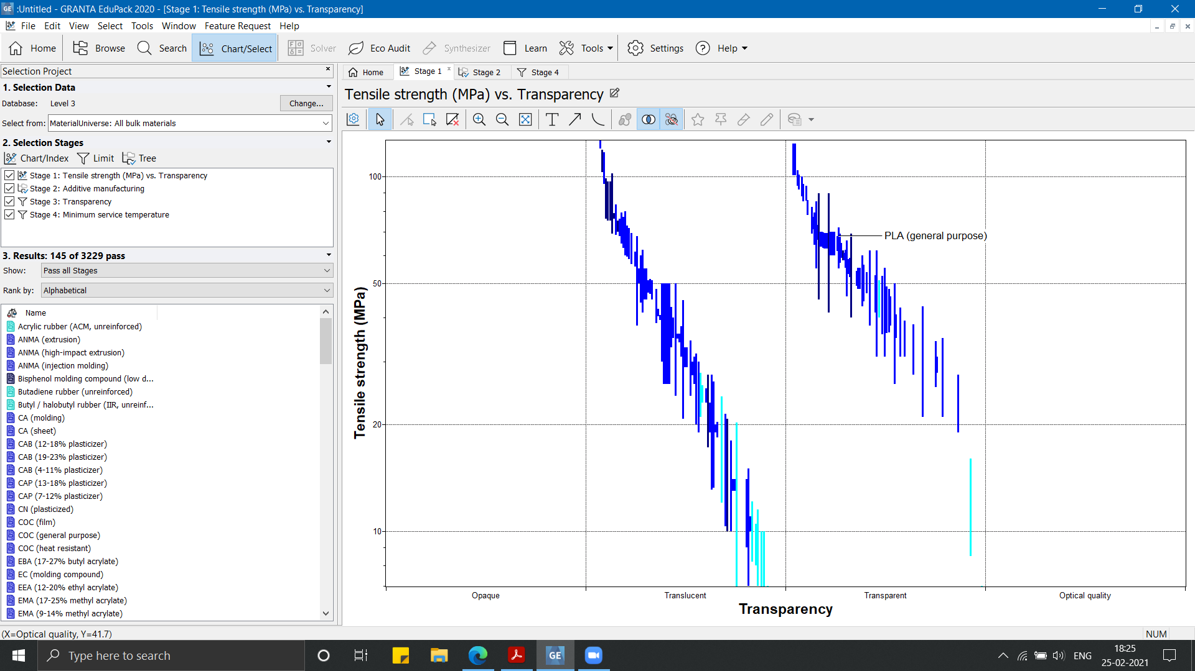

Slide 13
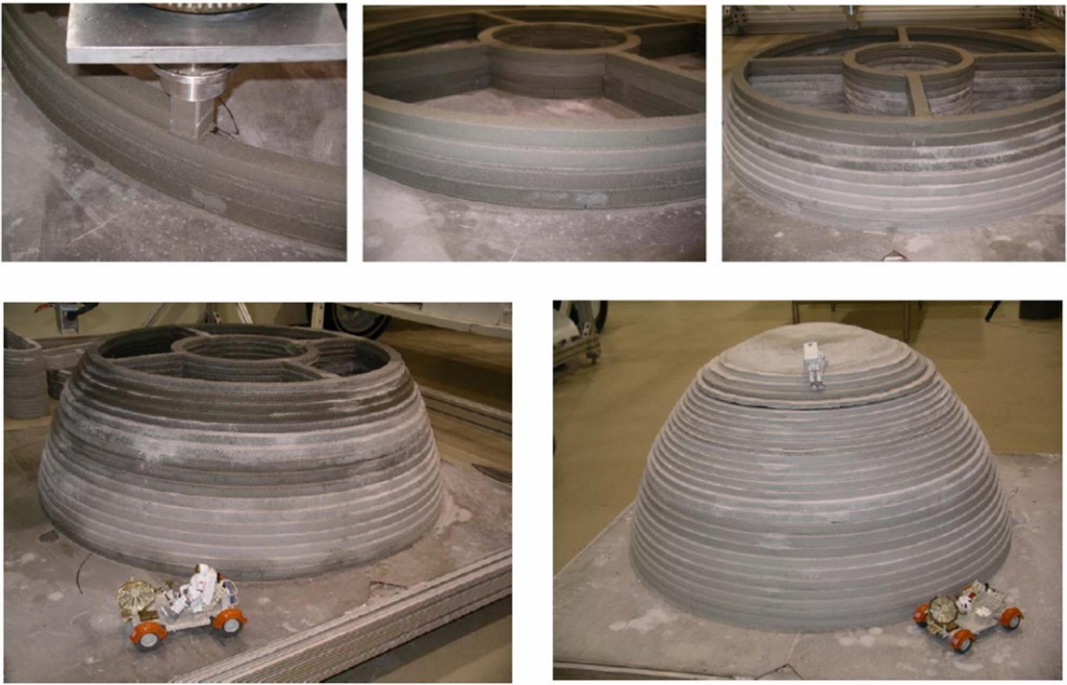
1.2 - Materialization
Martian Concrete
Properties Considered (similar to concrete)
can be deposited through a 3D printer layer by layer without any formwork support
fast printing speed
low resolution / rough printing
significant hardening time
ideal for large scale structures

Slide 14
1.3 - Voronoi Structures
Voronoi patterns give clue about nature’s tendency to favor efficiency in terms of:
nearest neighbor
shortest path
tightest fit
Voronoi pattern helps in partitioning of a plane containing “n” points, into convex polygons such that each polygon contains exactly one generating point; Any point taken in a given polygon is closer to its generating point than to any other.
Voronoi patterns offer high strength to weight ratio as required in any airborne system.

Slide 15
1.3 - Voronoi Structures
Scales:
Floorplan
Construction
Furniture

Slide 16
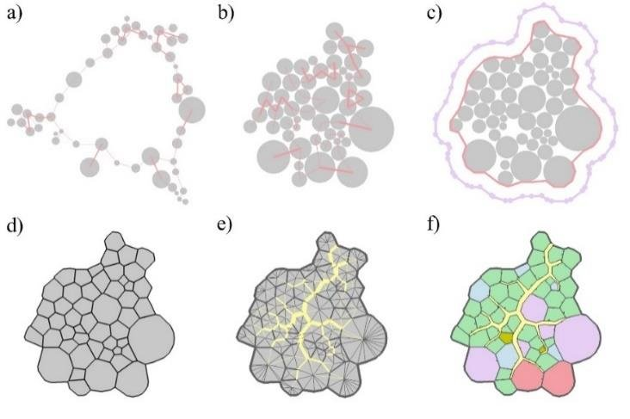
1.3 - Floor plan
a) spectral layout;
b) physics simulation;
c) offset of concave hull;
d) Voronoi tessellation;
e) generation of circulation using an ant-colony algorithm;
f) final floor plan.

Slide 17
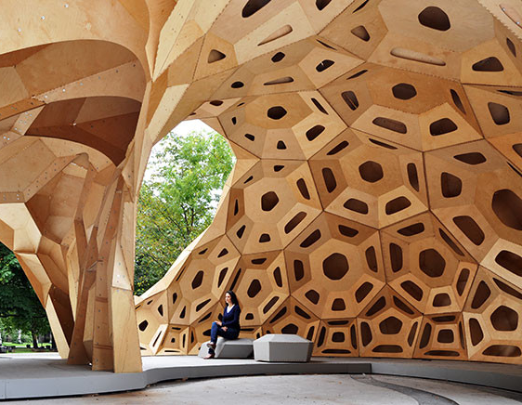
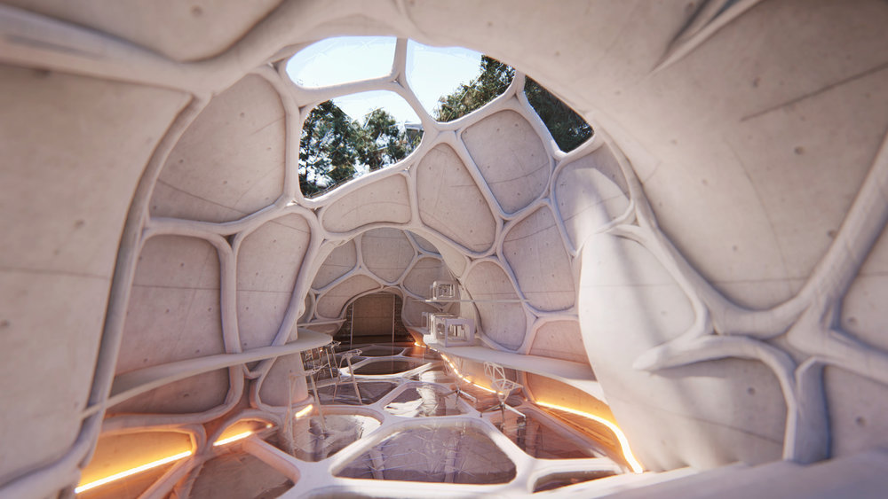
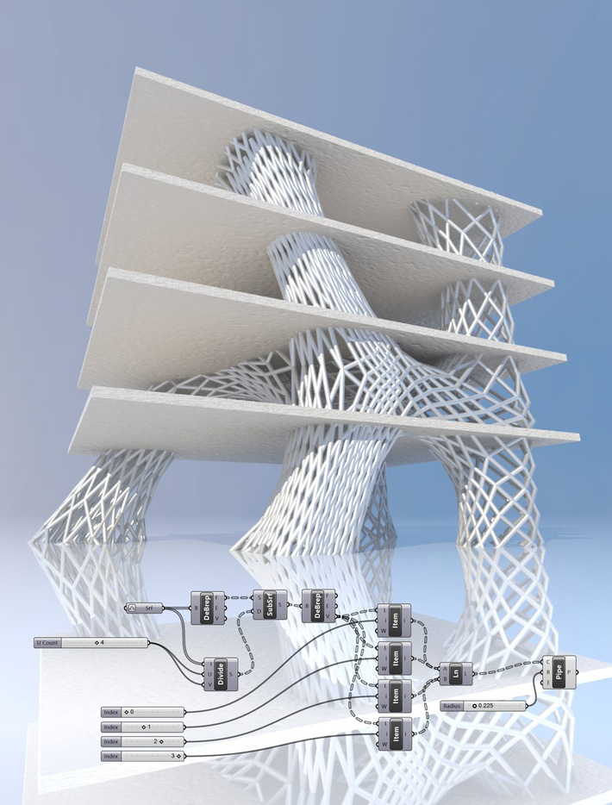
1.3 - Construction

Slide 18
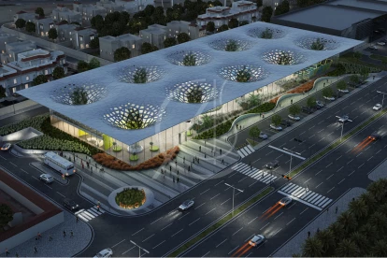
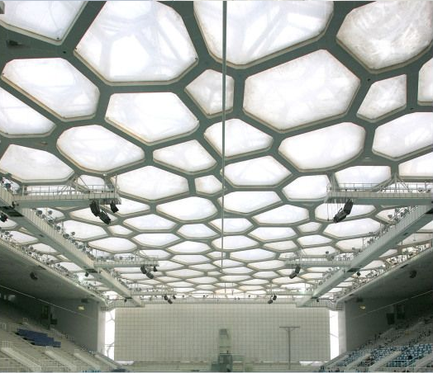
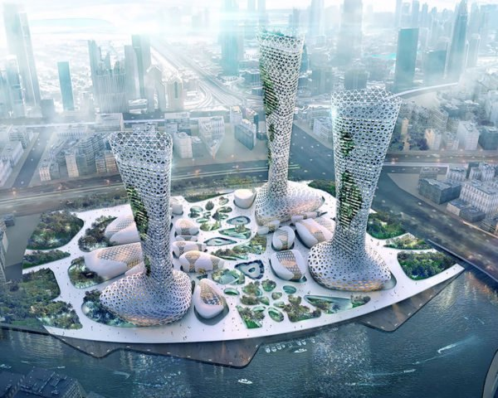
1.3 - Construction

Slide 19
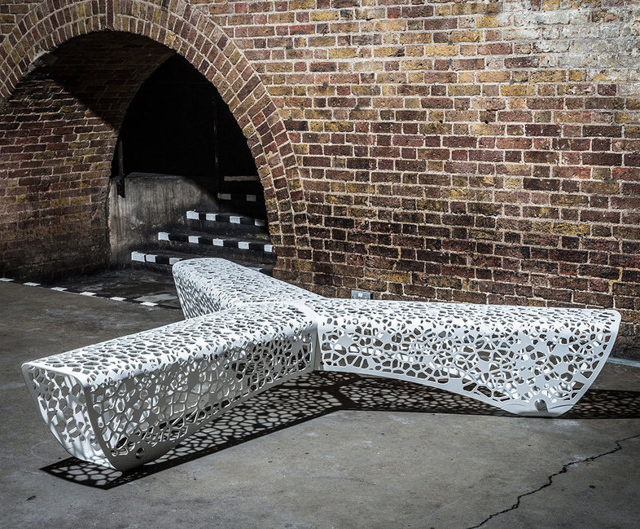
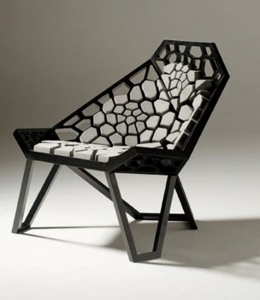
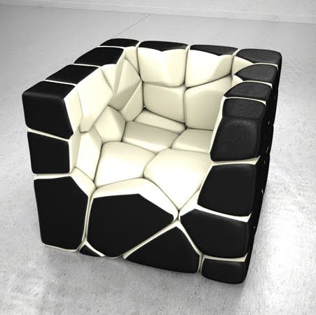
1.3 - Furniture

Slide 20
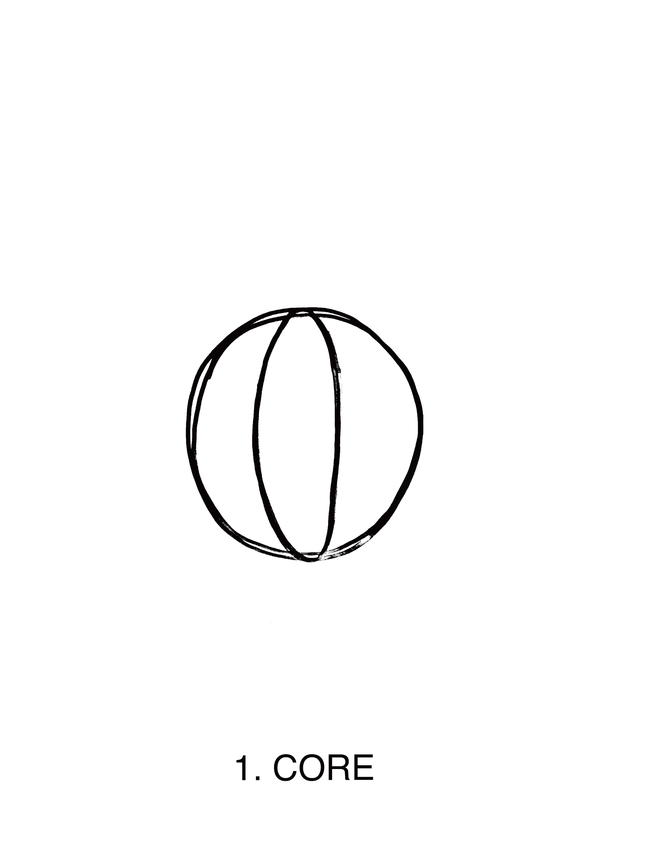
2.1 - Design proposal
Initial Idea

Slide 21
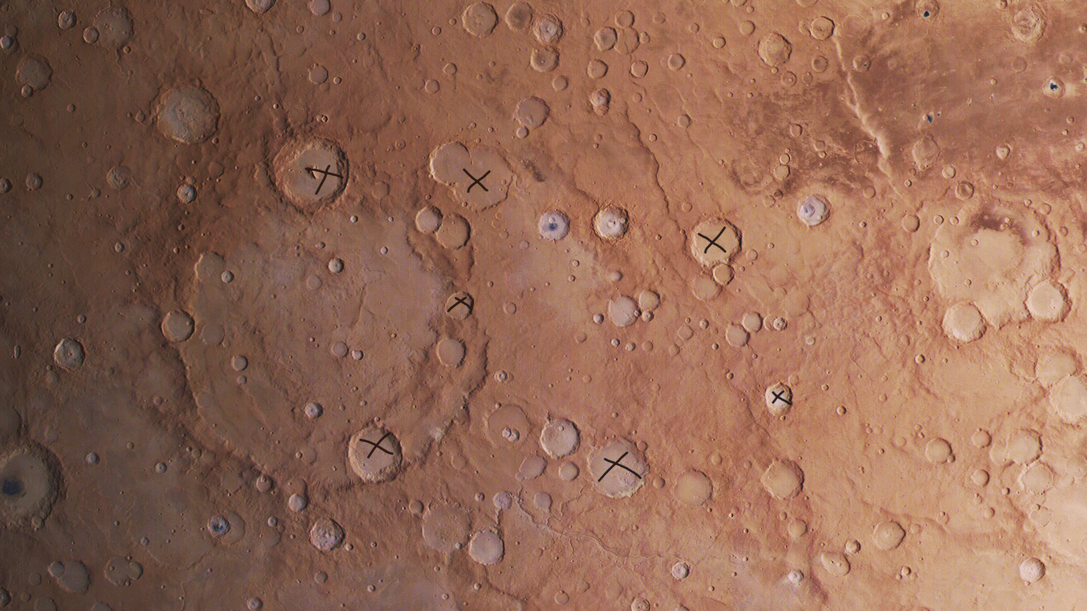
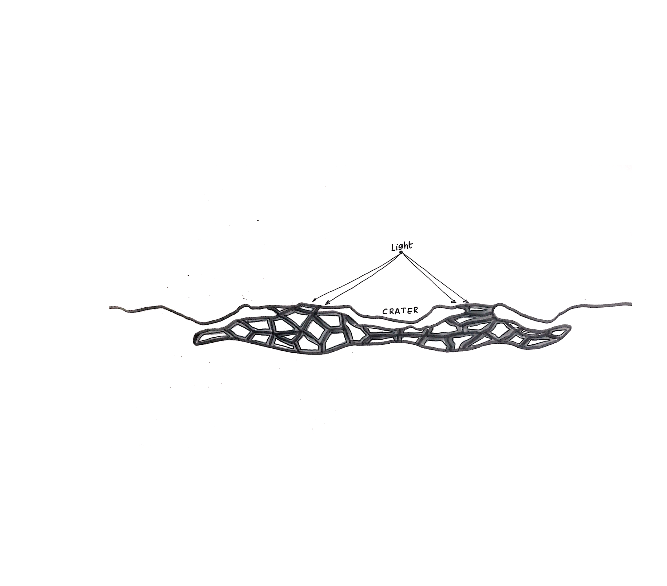
2.2 - Design proposal
Form
Use of existing craters on Mars
Bigger craters are the middle points
Smaller craters the connections

Slide 22
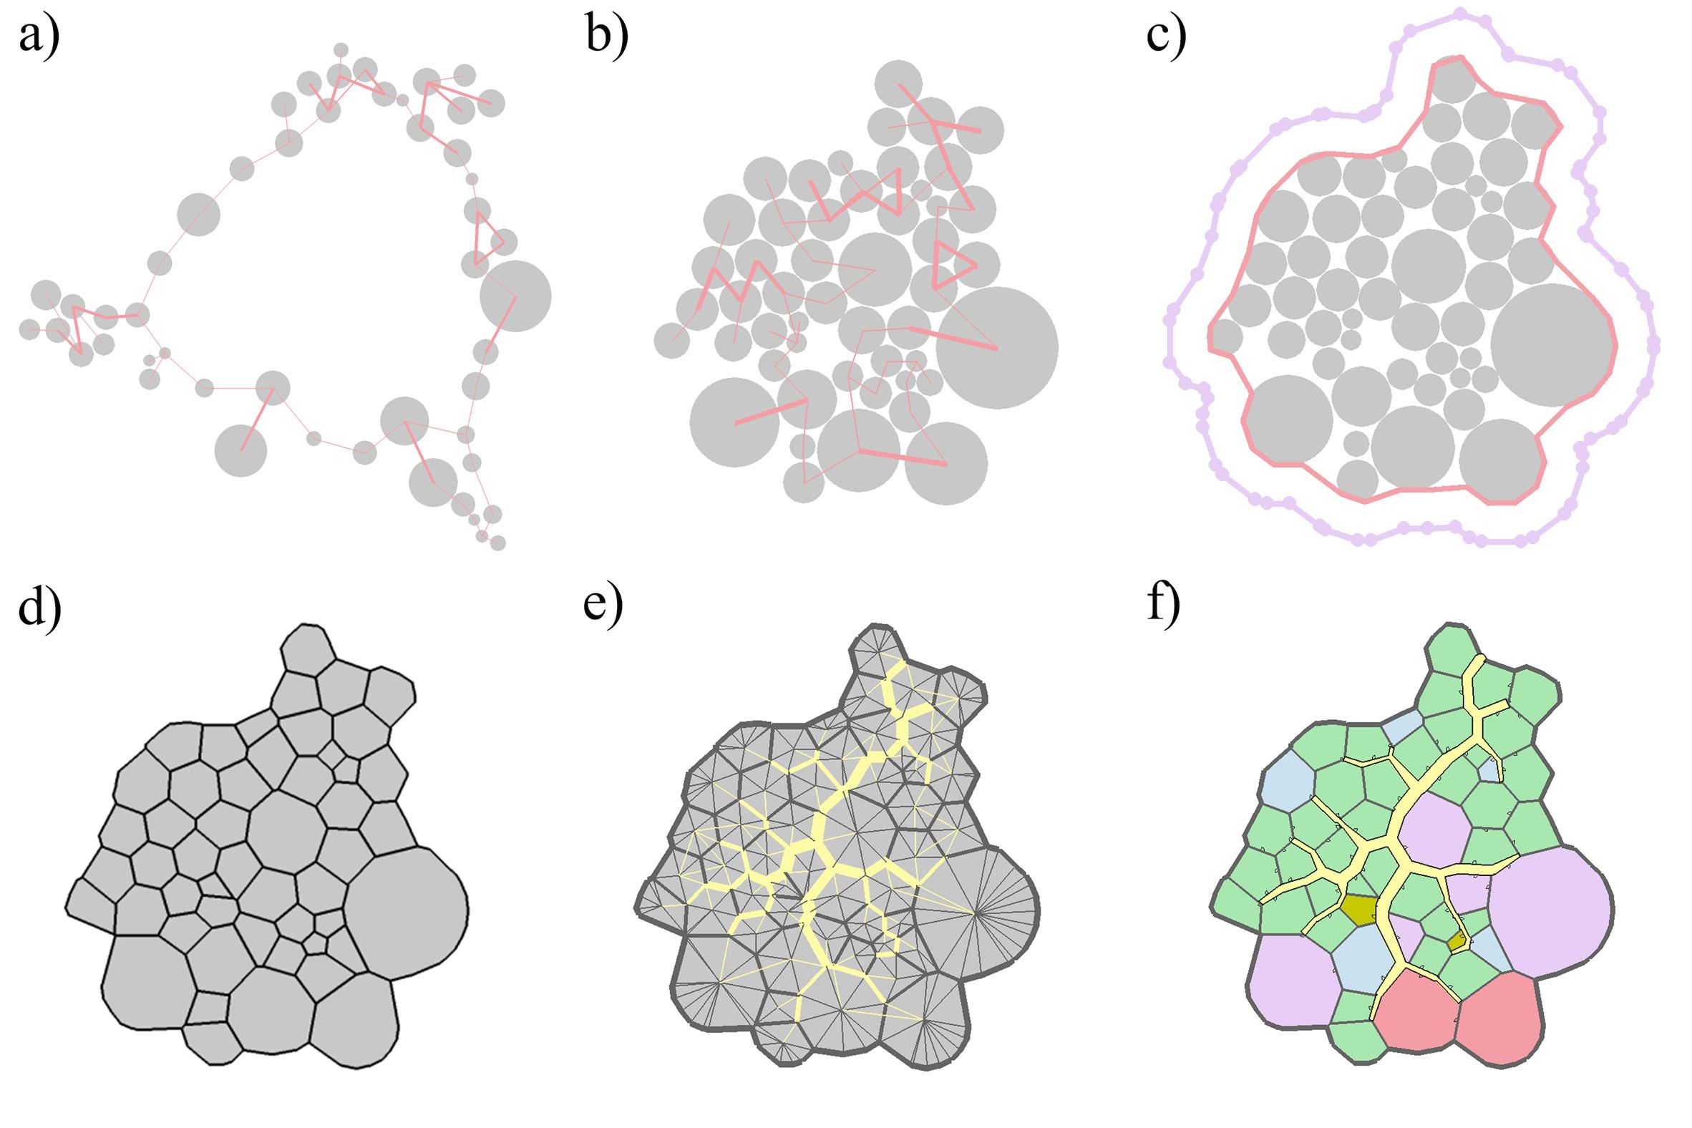
2.2 - Design proposal
Form
Use of the ant python script to generate the optimal layout between the points

Slide 23
2.3 - Design proposal
Function
Criteria per function
Python algorithm
Spaces to function

Slide 24
